Slide 1
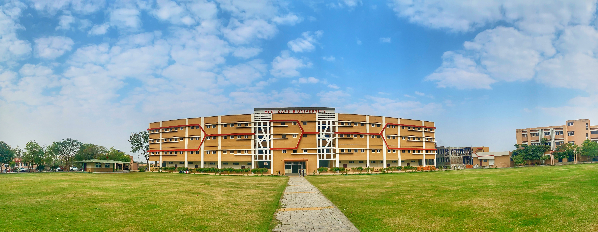

Engineering Physics (EN3BS05)
Ms Bhawna Kshirsagar
Medi-Caps University, Indore

Slide 2
Syllabus
Unit 1. Lasers and Optical Fibre
Unit 2. Interference and Diffraction
Unit 3. Quantum Mechanics
Unit 4. Mechanics and Crystal Physics
Unit 5. Polarization, Acoustics and Superconductivity

Slide 3
Scheme 3-1-2
3- Lectures
1- Tutorial
2- Laboratory Work
Total Credit: 5
Ms. Bhawna Kshirsagar , Assistant Professor (Physics Department) Medi-Caps University, Indore

Slide 4
EN3BS05 Engineering Physics 3-1-2
Text Books
Text Book of Optics by S. Chand Publication
Gour and Gupta , Engineering Physics, Dhanpat Rai Publication
S. L. Gupta, Engineering Physics
Text Book of Engineering Physics by M.N. Avadhanulu and P.G. Kshirsagar (Acoustics, Superconductivity)
Reference Books
Dr. M. N. Avadhanulu, Dr. R. S. Hemne, An Introduction to Laser- Theory and Applications. S. Chand Publications
Web Resources
http://phet.colarado.edu/en/simulations.
http://nptel.ac.in/courses/122103011/39.
Ms. Bhawna Kshirsagar , Assistant Professor (Physics Department) Medi-Caps University, Indore

Slide 5
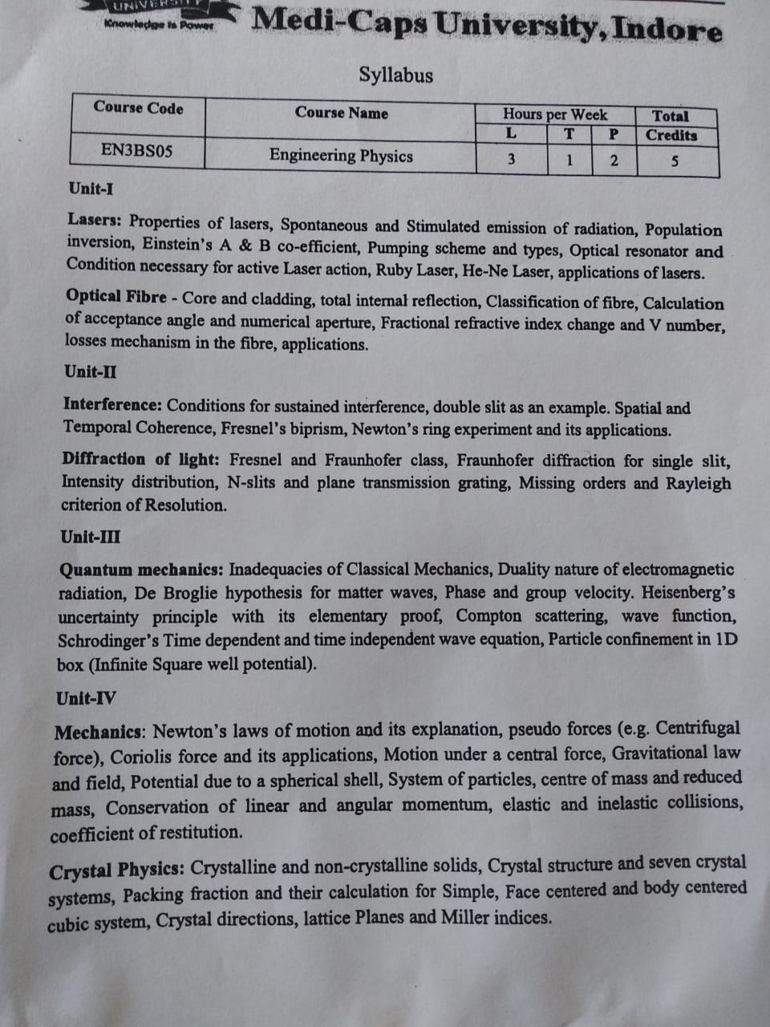

Slide 6
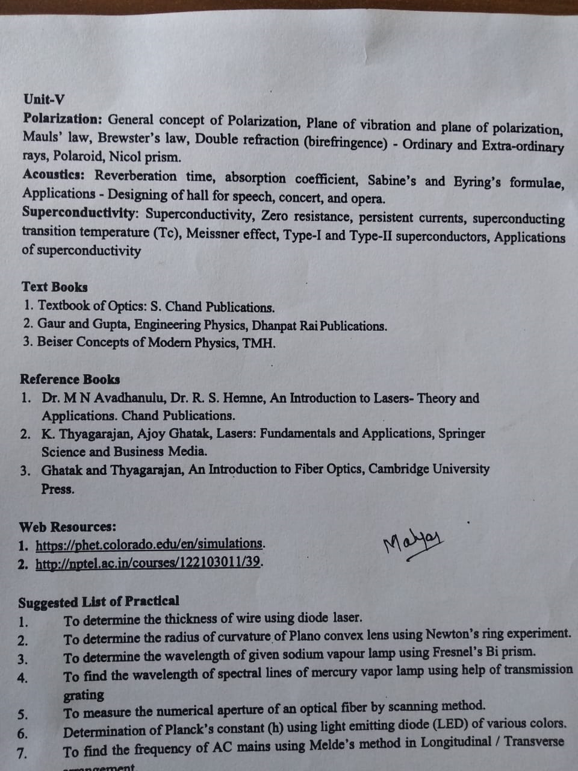

Slide 7
Unit 2: Wave Optics
Interference of Light
Diffraction of Light

Slide 8
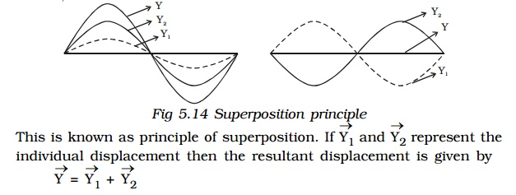
Principle of Superposition
When two or more waves simultaneously pass through the same medium, The resultant displacement of any particle is the vector addition of the displacements due to the individual waves.
Ms. Bhawna Kshirsagar , Assistant Professor (Physics Department) Medi-Caps University, Indore

Slide 9
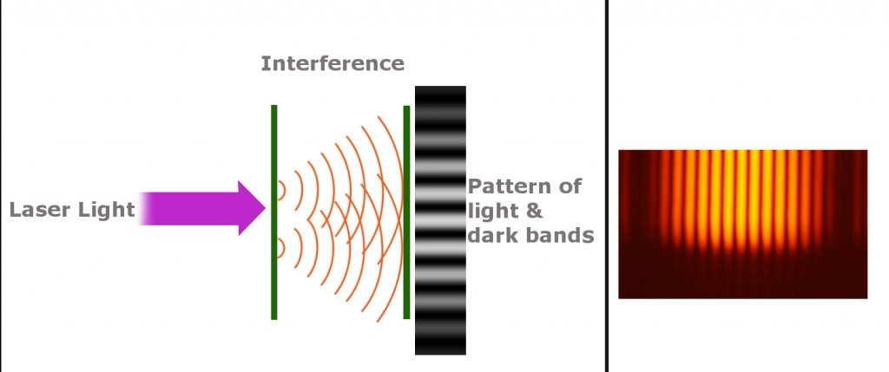
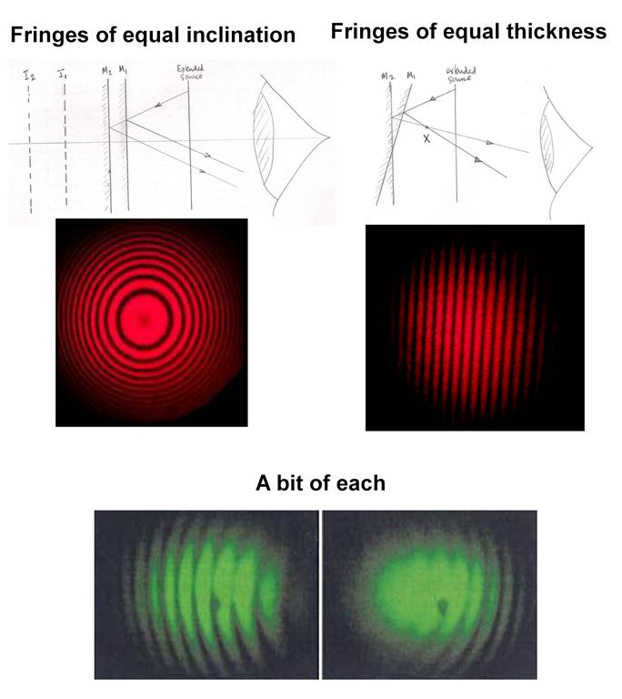
Interference of Light
When two or more than two coherent light waves superimpose, alternate dark and bright bands are obtained. These bands are called Interference Fringes and the phenomenon is called interference of light.

Slide 10
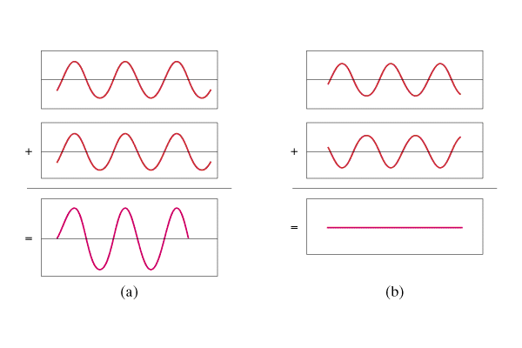
Constructive and Destructive Interference
Superposition - Overlapping waves add.
Constructive interference = crest meets crest, Trough meets trough
Destructive interference = crest meets trough
Destructive
Constructive

Slide 11
Coherent Sources:
same frequency,
nearly same amplitude and
constant phase difference
*Two independent monochromatic sources, emit waves of same wave length. But the waves are not in phase. So they are not coherent. This is because, atoms cannot emit light waves in same phase and these sources are said to be incoherent sources.

Slide 12
Methods of producing Coherent Sources
Wave front Division: YDSE, Fresnel’s Biprism
Amplitude Division: Newton’s Ring Experiment

Slide 13
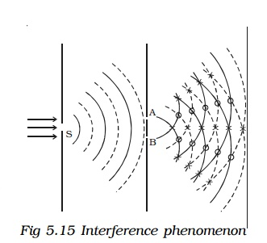
Young’s Double Slit Experiment
interference.

Slide 14
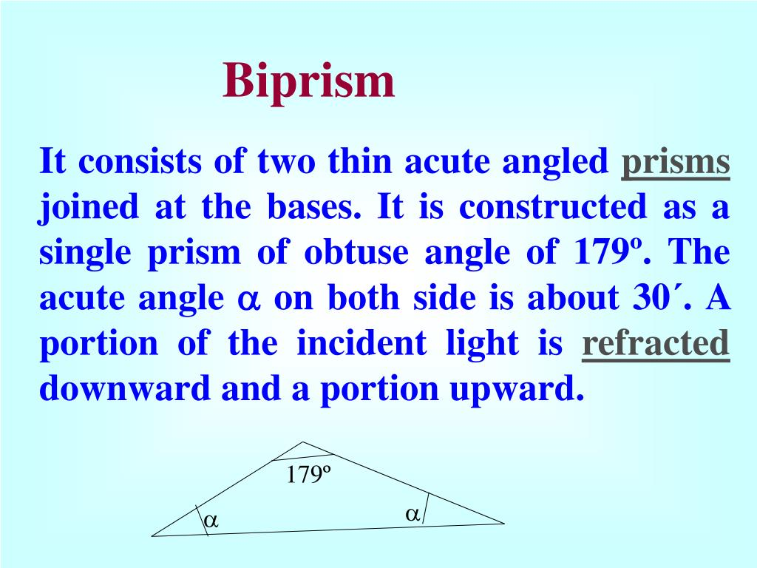
Fresnel’s Biprism

Slide 15
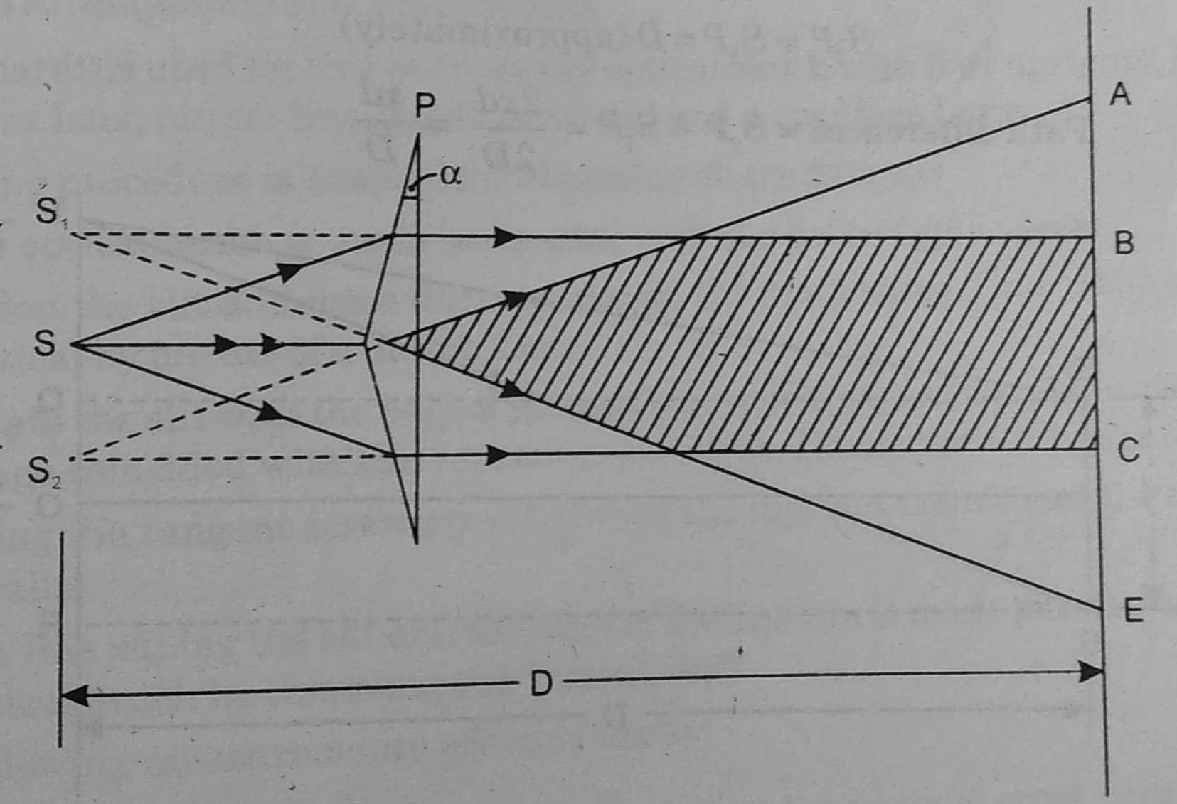
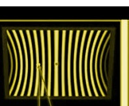
Fresnel’s Biprism

Slide 16
Shape of Fringes
Hyperbolic in shape but appears as Straight because of large eccentricity.

Slide 17
Applications of Fresnel’s Biprism
Wavelength of monochromatic light source
Thickness of Thin transparent sheet
R.I. of thin transparent sheet

Slide 18
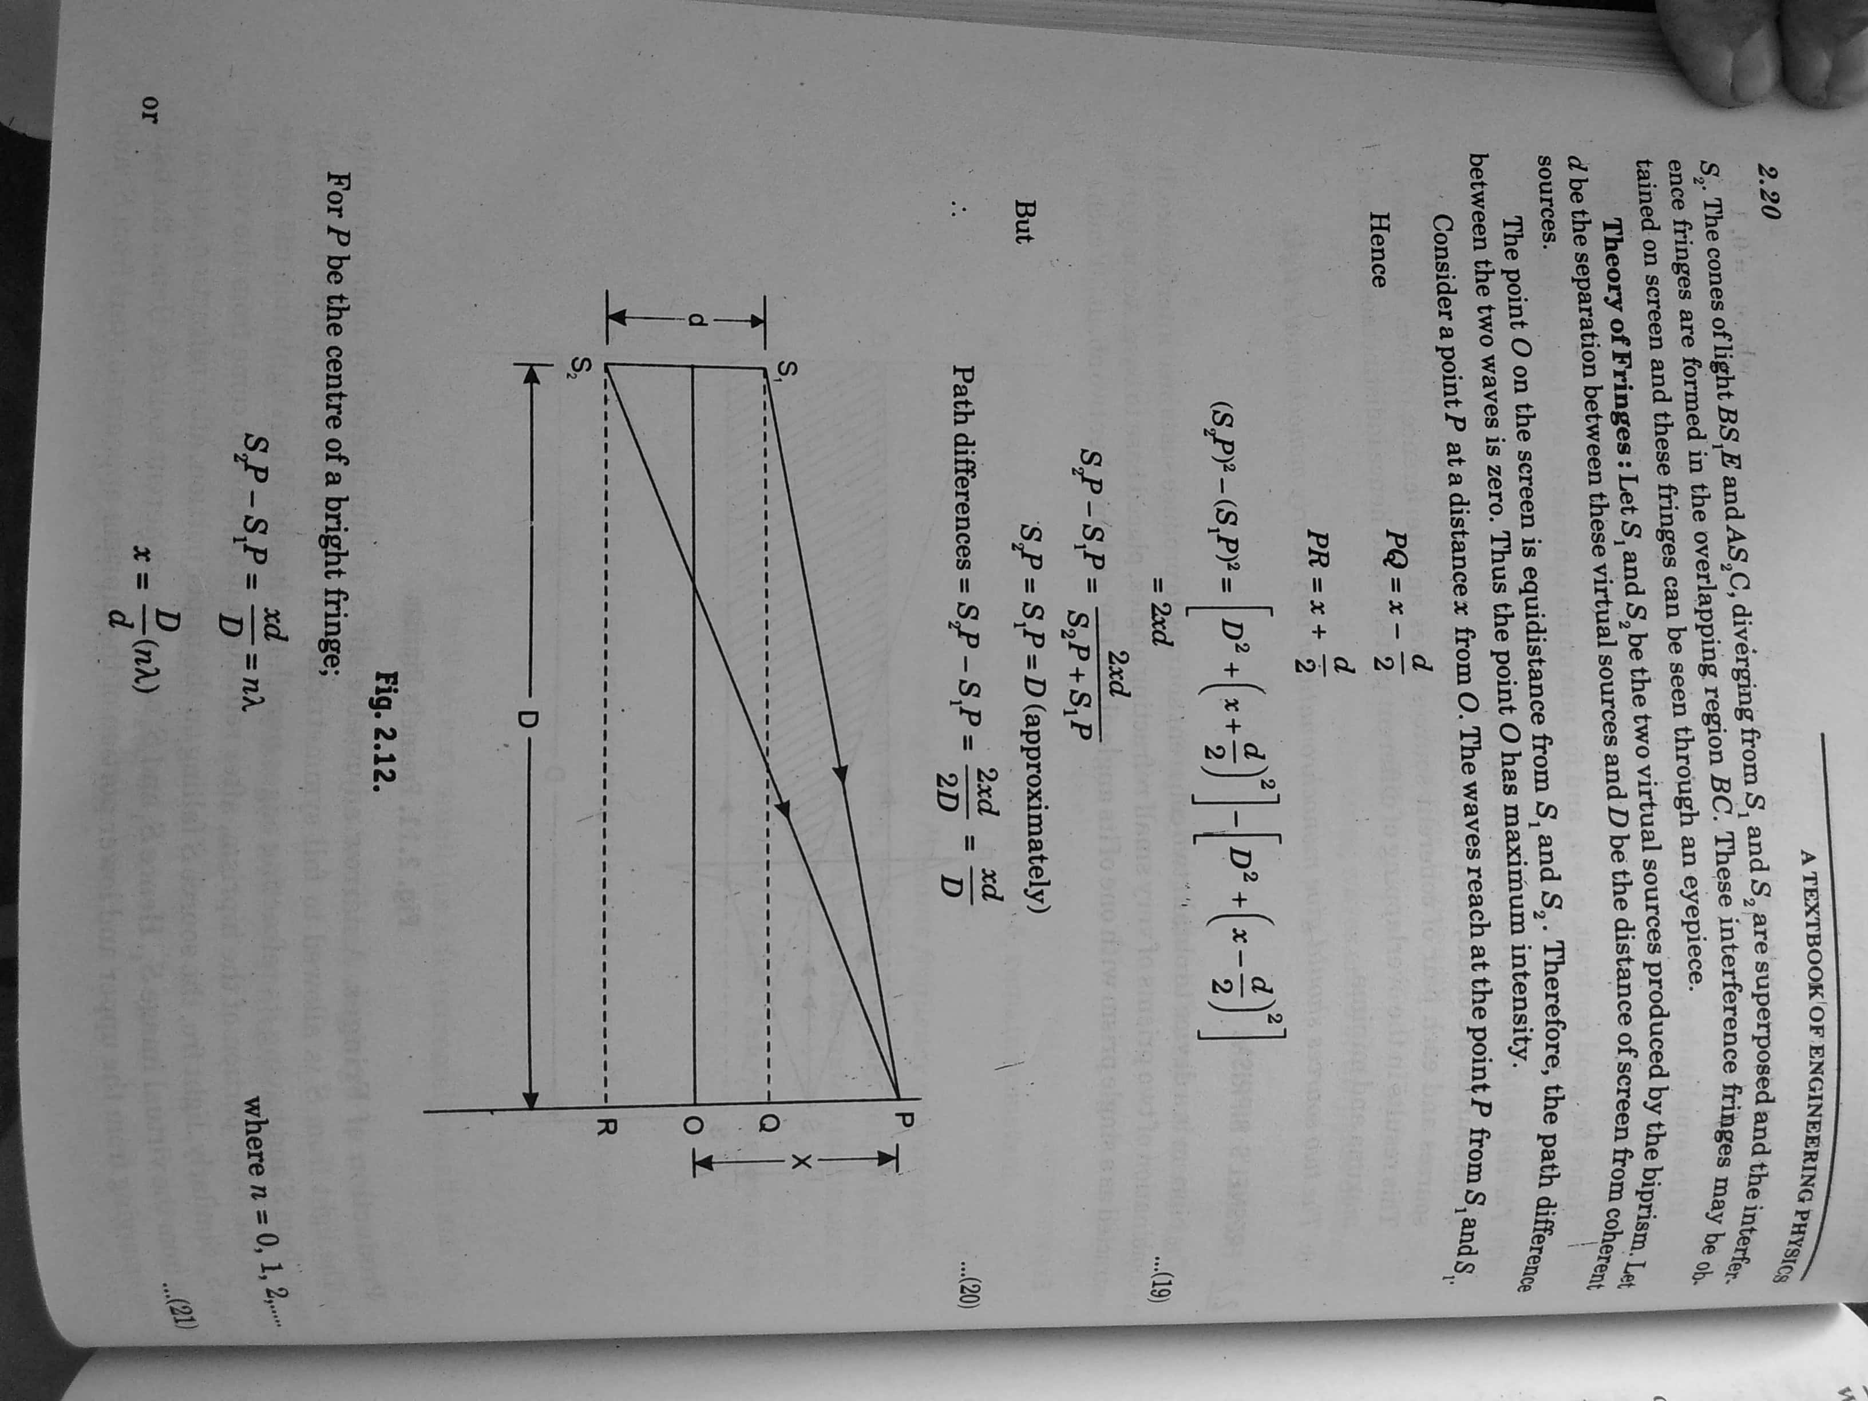
Fringe Width

Slide 19
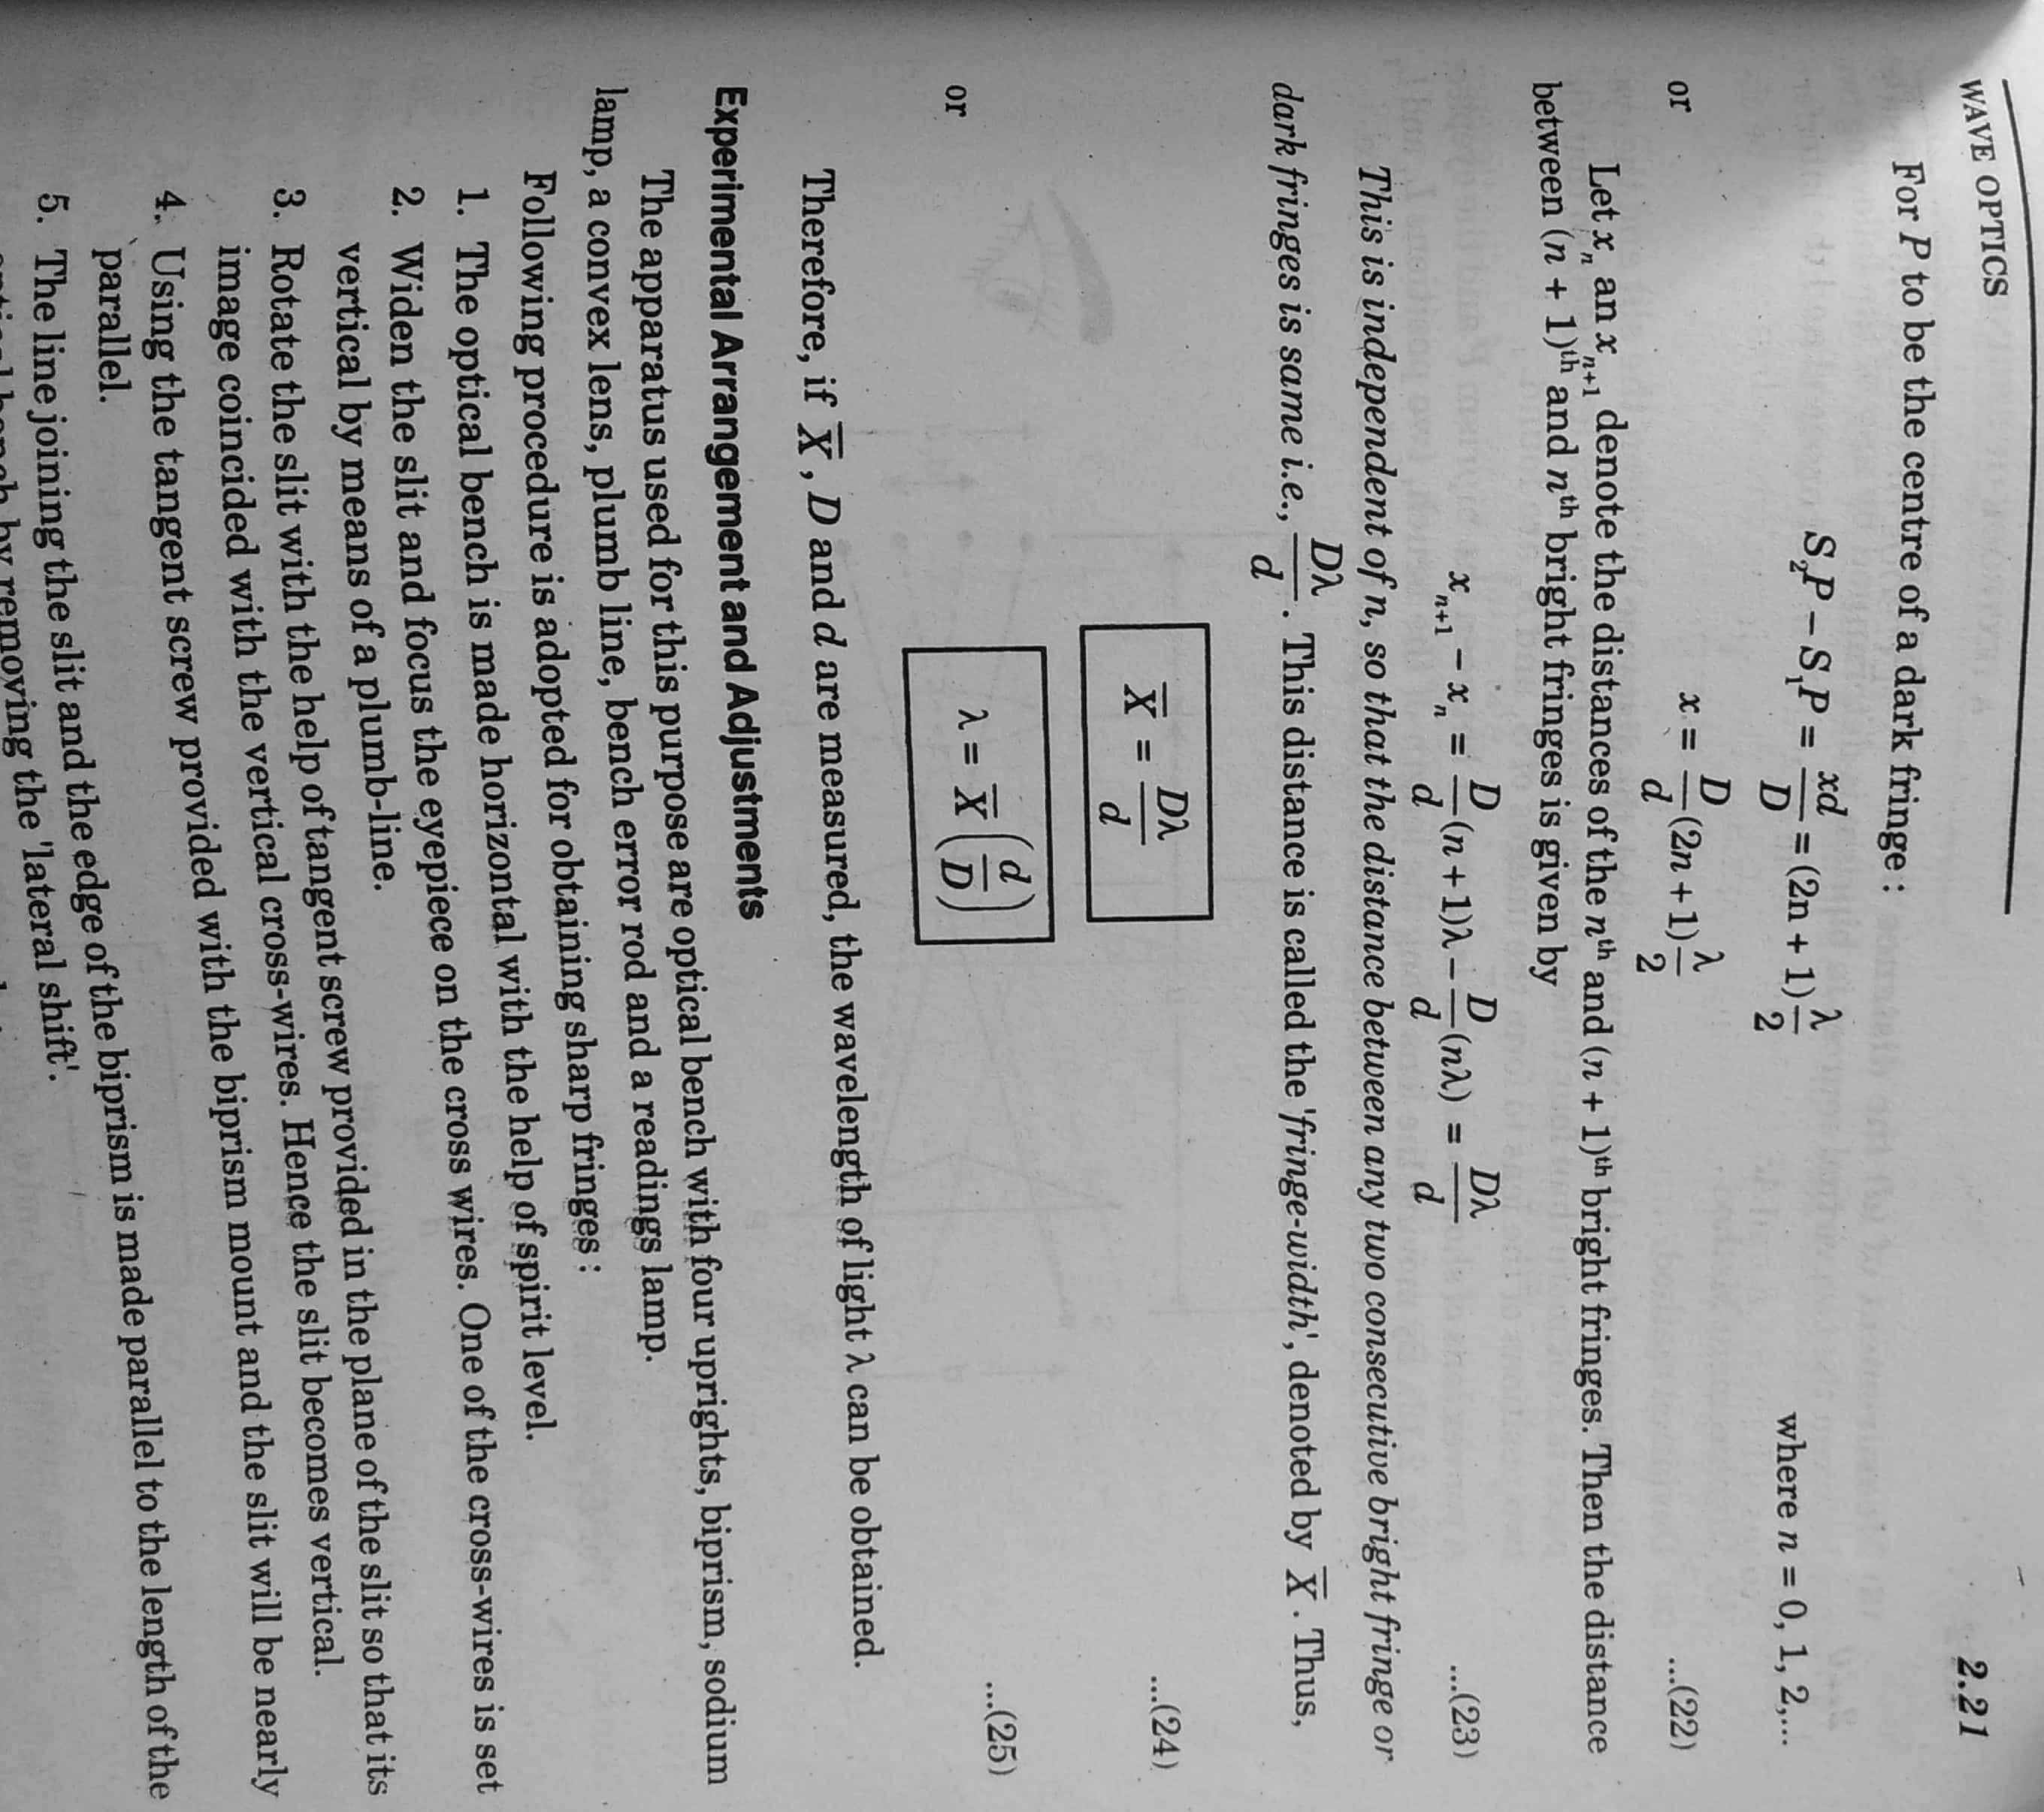
Fringe Width contd……….

Slide 20
Fringe Width contd……….
Fringe width depends on
Distance between source and screen
Separation between virtual sources
Wavelength of mono. light used

Slide 21
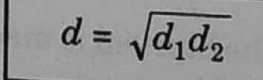
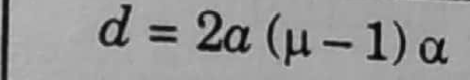
Methods of finding ‘d’
Displacement Method
Deviation Method
μ= R.I. of Biprism
α= Refracting angle

Slide 22
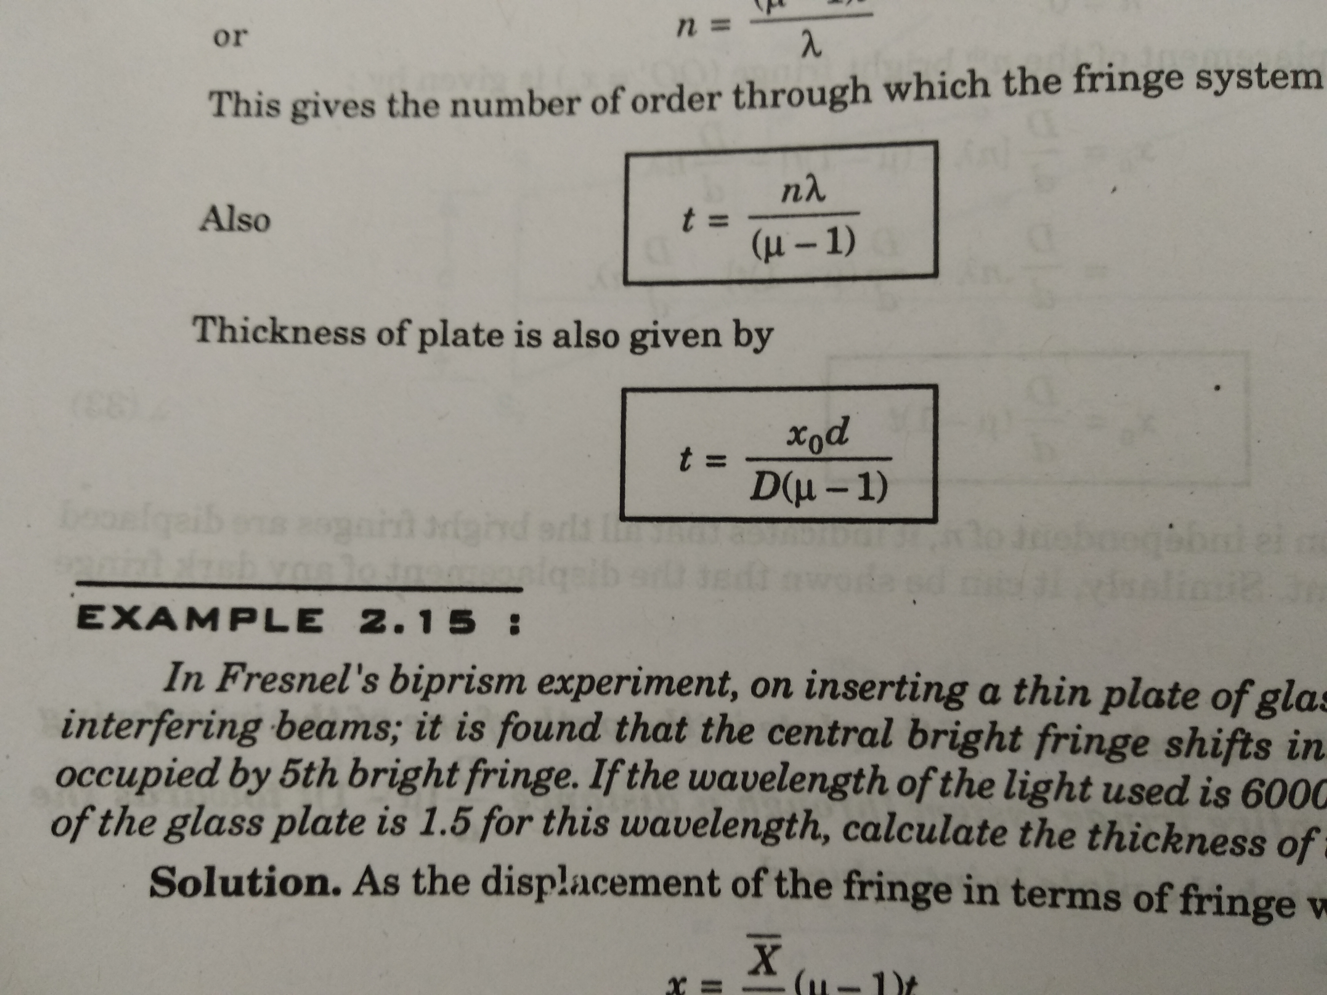
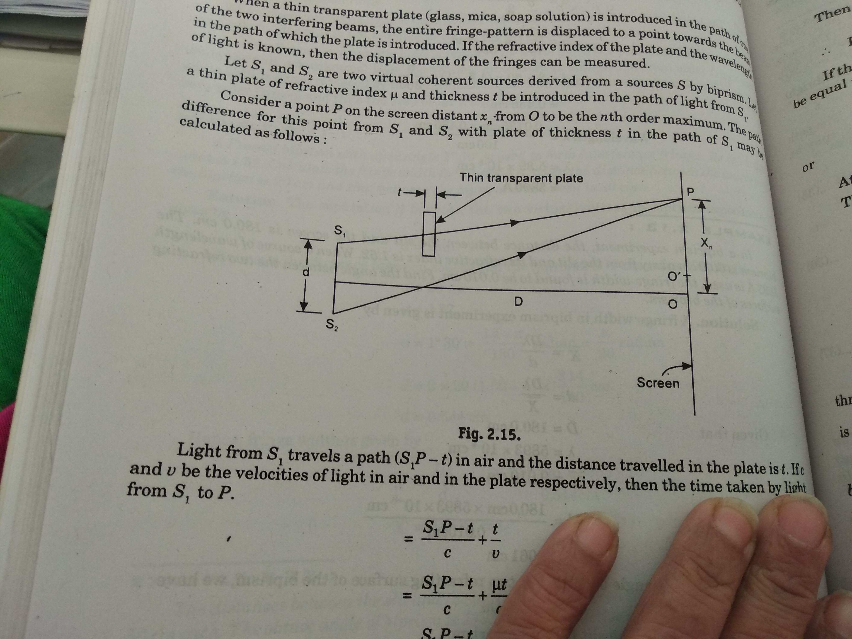
Application 2 and 3

Slide 23
Division of amplitude
Thin Film
A thin film is a film having thickness of the order of wavelength of light
It may be a liquid film, air film, soap bubble etc.

Slide 24
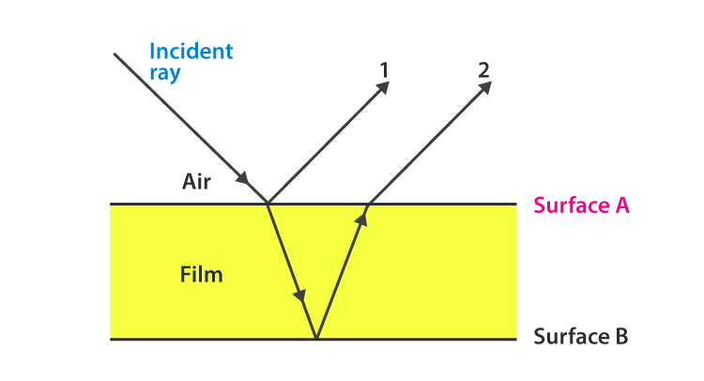
Thin Parallel Film
Film of thickness from 0.5 to 10 m is a transparent medium of glass, mica, air enclosed between glass, soap film, etc. When the light is made incident on this thin film partial reflection and partial refraction occur from the top surface of the film. The refracted beam travels in the medium and again suffers partial reflection and partial refraction at the bottom surface of the film. In this way several reflected and refracted rays are produces by a single incident ray. As they moves are superimposed on each other and produces interference pattern.

Slide 25
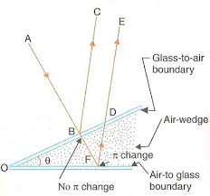
Wedge Shaped Film

Slide 26
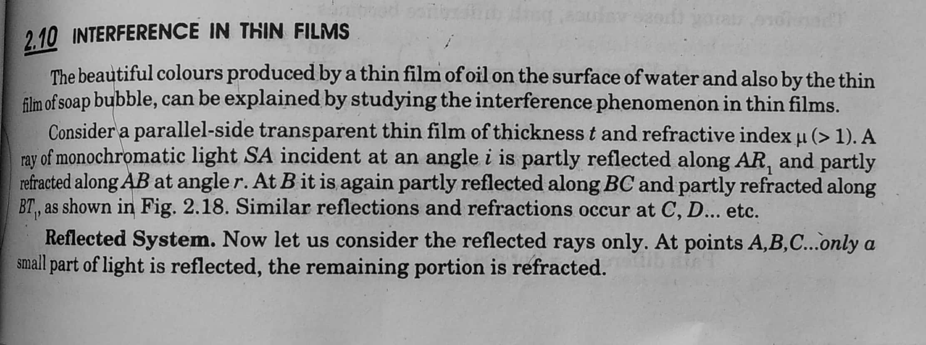
Interference in Thin Film

Slide 27
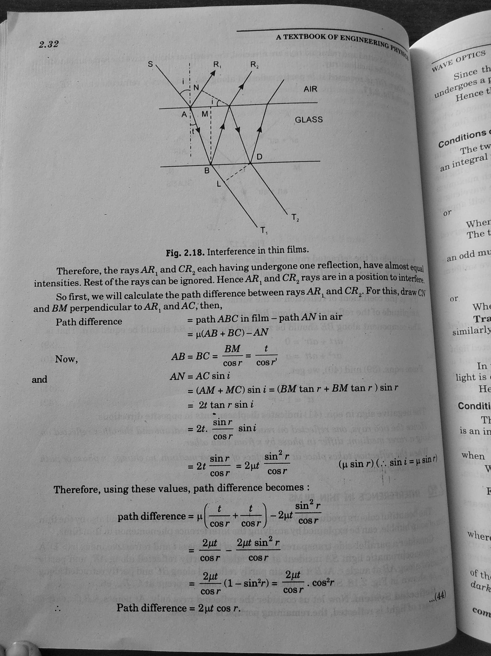

Slide 29
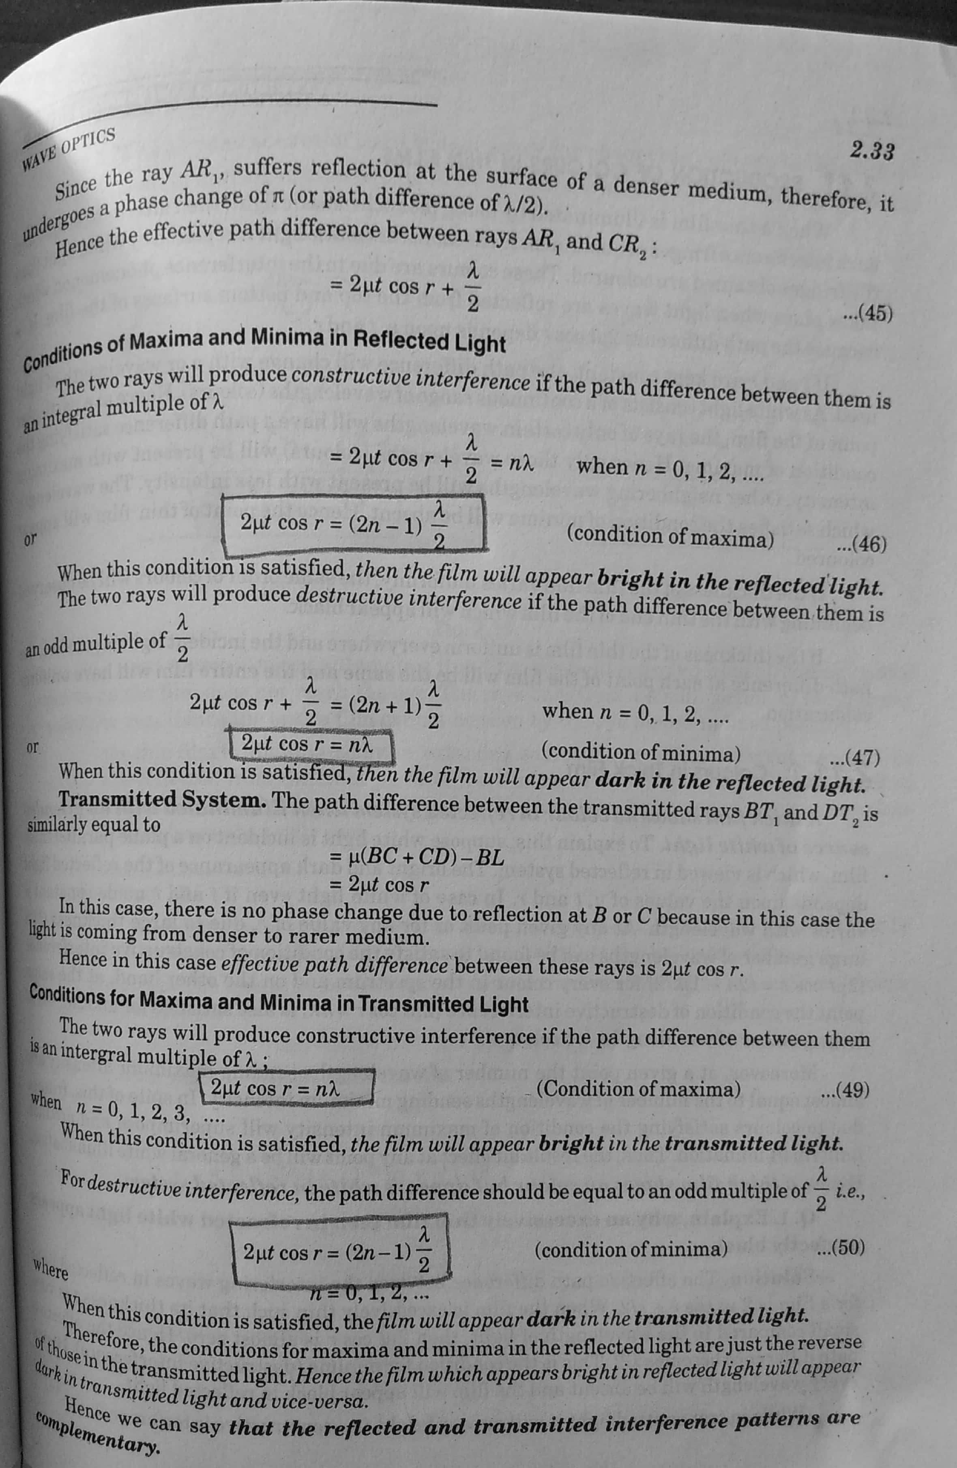

Slide 31
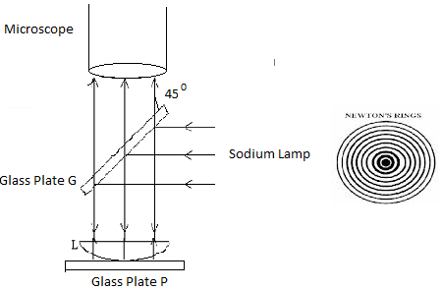
Newton’s Ring Experiment Interference by division of amplitude
When a Plano-convex lens with its convex surface is placed on a plane glass sheet, an air film of gradually increasing thickness is formed between the lens and the sheet. The thickness of film at the point of contact is zero. If monochromatic light is allowed to fall normally on the lens, and the film is viewed in reflected light, alternate bright and dark concentric rings are seen around the point of contact. These rings were first discovered by Newton, that's why they are called NEWTON'S RINGS .

Slide 32
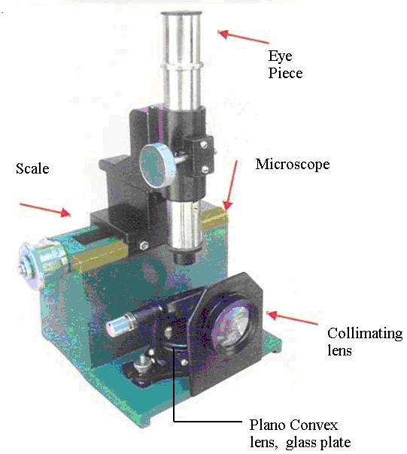
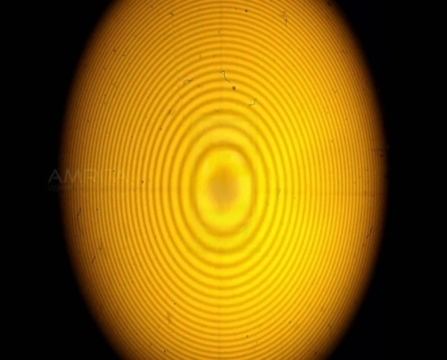

Slide 33
Explanation
Newton's rings are formed due to interference between the light waves reflected from the top and bottom surfaces of the air film formed between the lens and glass sheet.
An air film of varying thickness is formed between the lens and the glass sheet. When a light ray is incident on the upper surface of the lens, it is reflected as well as refracted. When the refracted ray strikes the glass sheet, it undergo a phase change of 180^{O} on reflection. Interference occurs between the two waves which interfere constructively if path difference between them is nλand destructively if path difference between them is (2n+1) λ /2,producing alternate bright and dark rings.

Slide 34
Applications
1) Wavelength of light 2) R.I. of liquid 3) Surface quality of lens

Slide 35
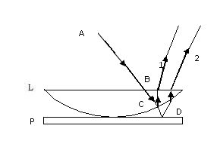
THEORY
P.d.=2μt cos r +λ/2 μ = R. I. of film(air) ,
t =Thickness of film , r =Inclination of the ray λ/2 =Phase change of π at the lower surface of air film In our case μ=1 and r=0 Hence P.d.= 2t +λ/2 …………………..(1)

Slide 36
Theory contd……………..
(1) Condition for Dark Ring: For Minimum Intensity : P.d.=(2n+1) λ/2 Also, P.d. = 2t +λ/2 (from 1) 2t +λ/2 =(2n+1) λ/2 Or 2t= nλ……………………...(2)
where n=1,2,3,…….
(2) Condition for Bright Ring: For Maximum Intensity :P.d.=nλ Also, P.d.= 2t +λ/2 (from 1) 2t +λ/2 = nλ Or 2t=(2n-1) λ/2 …………………..(3)
where n=1,2,3,…….
At point of contact P.d.= λ/2 (condition for minima) So, the center of Newton’s Ring is dark

Slide 37
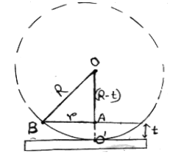
Diameter of Rings
From BAO
R² = (R-t)² +r²
Or
r² = 2Rt- t²
Or
2t= r² /R ………(4)

Slide 38
Diameter of Rings contd…..
Diameter of Bright Ring
r² /R =(2n-1) λ/2
Or
The diameter of bright rings are proportional to the square root of odd natural nos.
Diameter of Dark Ring
r² /R =n λ
The diameter of bright rings are proportional to the square root of odd natural nos.

Slide 39
Wavelength of light

Slide 40
R.I. of Liquid
When liquid is introduced between lens and plate ,the diameter of ring decreases i.e. the rings are contracted

Slide 41
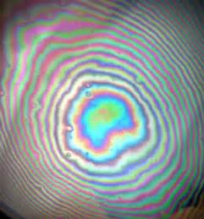
NEWTON’S RING WITH WHITE LIGHT

